Slide 1
Antepartum Fetal Assessment
In the name of God
Dr. Mahboobe Sadat Miri
Faculty member of Kamali Hospital
Summer 2024

Slide 2
Types of fetal assessment
fetal movement counts (“kick counts)
Fetal movement counting (also called “kick counts”) is a test that the woman can do at home. There are different ways kick counts can be done. the health care professional will tell her how often to do it and when to notify him or her.
Daily fetal movement counting, such as the Cardiff “count-to-ten” method using kick charts, is a way of screening for fetal well-being, by which a woman counts daily fetal movements to assess the condition of her baby.

Slide 3
INSTRUCTIONS
Choose one period during the day to count. should choose a time when the baby is normally active.
Count at the same time every day.
chart how long it takes to reach 10 movements.
Count all recognizable movements. This may be a kick, a punch, rolling, stretching, etc. If you feel a short flurry of kicks, count that as one movement. Do not count hiccups.

Slide 4

A way to assess intrauterine well-being in which the expectant woman records fetal movement during her usual activities. There should be at least 10 movements within a 2-hour period; if fewer than 10 movements are perceived, further medical evaluation is needed.

Slide 5


Slide 6
Non Stress Test (NST)
Looks to accelerations in FHR as an indication of fetal well-being; a fetus that is NOT acidotic or neurologically depressed will have a HR that temporarily accelerates with fetal movement
  REACTIVE: ≥2 accelerations within 20 minutes
  NONREACTIVE: <2 accelerations in 40 minutes
Accelerations ≥ 32 weeks: 15 BPM above baseline + lasting ≥ 15s⁴⁻⁵
Accelerations < 32 weeks: 10 BPM above baseline + lasting ≥ 10s
If it is believed that there is an absence of accelerations 2/2 fetal sleep cycles, vibroacoustic stimulation-elicited accelerations are a valid prediction of FWB⁶⁻⁹
Advantages: doesn’t require an IV, oxytocin, or contractions
  no contraindications

Slide 7
Non Stress Test: Significance
Non reactivity is associated with:
  Fetal distress in labor (5x)
  Low 5 min. Apgar scores (6x)
  Increased Fetal Death Rate (7-12x)
Decelerations during a Reactive NST:
  Increased distress in labor (2 – 3X)
  IUGR (8 – 12X)
  Fetal Death (5X)

Slide 8
The non-stress test
The non-stress test measures the fetal heart rate in response to fetal movement over time. The term “non-stress” means that during the test, nothing is done to place stress on the fetus.
This test may be done in the health care professional’s office or in a hospital. The test is done while woman are reclining or lying down and usually takes at least 20 minutes. A belt with a sensor that measures the fetal heart rate is placed around the abdomen. The fetal heart rate is recorded by a machine.

Slide 9
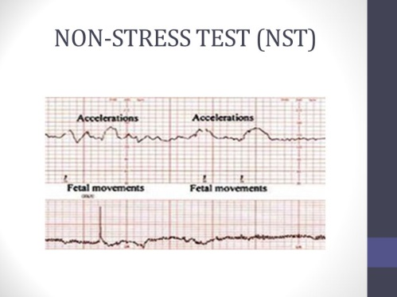

Slide 10
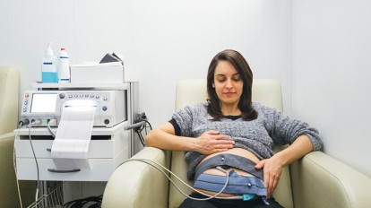

Slide 11
Results mean :
If two or more accelerations occur within a 20-minute period, the result is considered reactive or “reassuring.” A reactive result means that for now, it does not appear that there are any problems. A nonreactive result is one in which not enough accelerations are detected in a 40-minute period. It can mean several things. It may mean that the fetus was asleep during the test. If this happens, the test may last 40 more minutes, or the fetus may be stimulated to move with sound projected over the mother’s abdomen. A nonreactive result can occur if the woman has taken certain medications. It also can mean that the fetus is not getting enough oxygen.

Slide 12
Biophysical profile
A biophysical profile (BPP) may be done when results of other tests are non-reassuring. It uses a scoring system to evaluate fetal well-being in these five areas:
Fetal heart rate
Fetal breathing movements
Fetal body movements
Fetal muscle tone
Amount of amniotic fluid

Slide 13
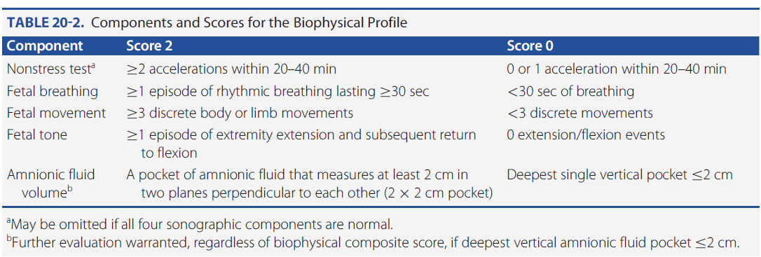

Slide 14
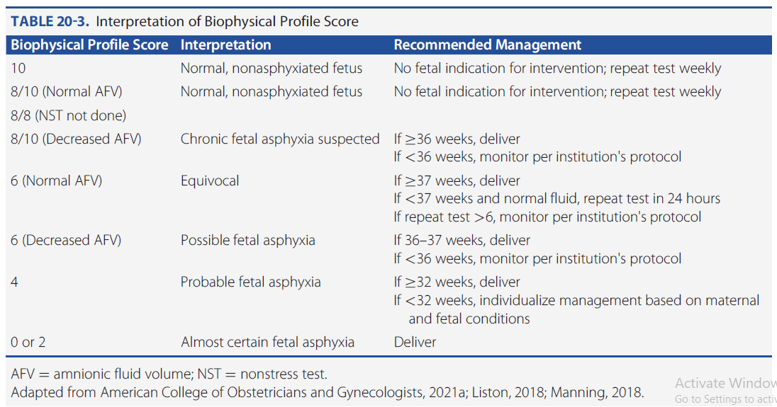

Slide 15
Contraction stress test
A contraction stress test (CST) is performed near the end of pregnancy (34 weeks' gestation) to determine how well the fetus will cope with the contractions of childbirth. The aim is to induce contractions and monitor the fetus to check for heart rate abnormalities using a cardiotocograph. A CST is one type of antenatal fetal surveillance technique.

Slide 16
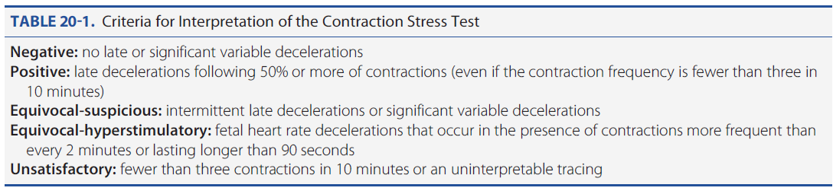

Slide 17
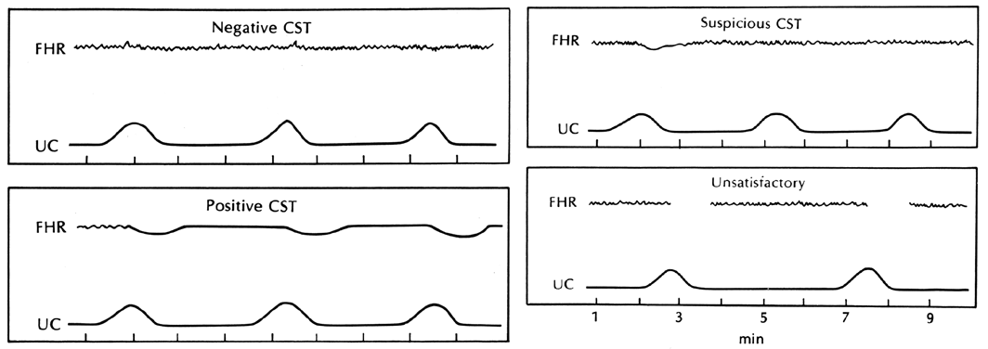
Contraction Stress Test

Slide 18
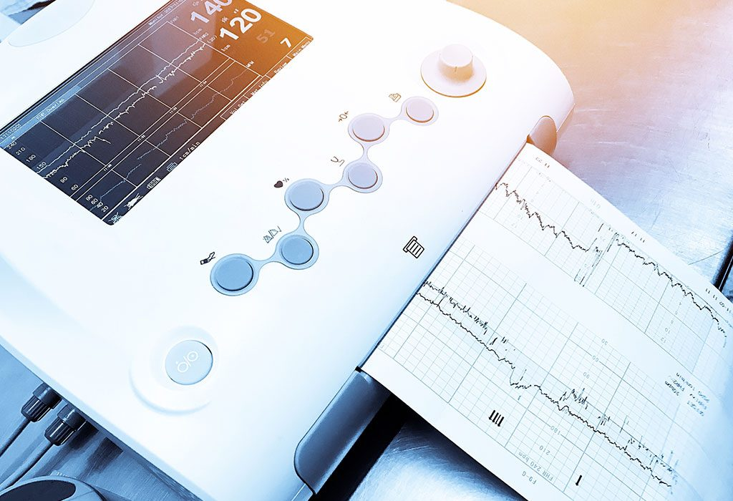

Slide 19
Uses
The CST is used for its high negative predictive value. A negative result is highly predictive of fetal wellbeing and tolerance of labor. The test has a poor positive predictive value with false-positive results in as many as 30% of cases. A positive CST indicates high risk of fetal death due to hypoxia and is a contraindication to labor. Patient's obstetricians usually consider operative delivery in such situations.

Slide 20
Contraindication
This "stress test" is usually not performed if there are any signs of
Premature birth
placenta previa, vasaprevia
Cervical incompetence
Multiple gestation.
previous classic cesarean section
Other contraindications include but are not limited to previous uterine incision with scarring, previous myomectomy entering the uterine cavity, and PROM. Any contraindication to labor is contraindication to CST.

Slide 21
CST is performed weekly. as the fetus is assumed to be healthy after a negative test and should remain so for another week. This test is done in hospital or clinic setting. External fetal monitors are put in place and then either nipple stimulation or IV Pitocin (oxytocin) is used to stimulate uterine contractions.

Slide 22
Nipple stimulation
This is a procedure that relies on endogenous release of oxytocin following nipple stimulation, and is conducted by the patient.
The nurse instructs the patient on the procedure, as follows. One nipple is massaged gently through clothing until a contraction begins, or for a maximum of 2 minutes. If at least 3 contractions in 10 minutes is not achieved, then the patient rests for 5 minutes and the other nipple is stimulated.

Slide 23
Oxytocin challenge test (OCT)
If adequate contractions (at least 3 in 10 minutes) cannot be achieved with nipple stimulation, an oxytocin challenge test may be performed.
It involves the intravenous administration of exogenous oxytocin to the pregnant woman. The target is to achieve around three contractions every ten minutes

Slide 24
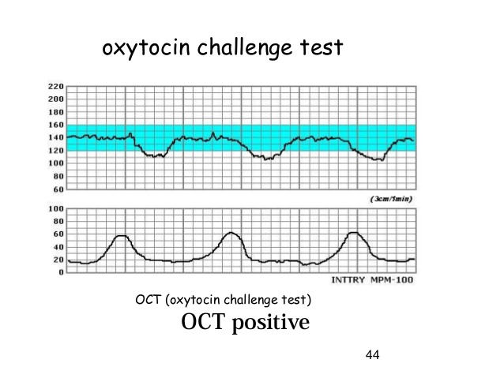

Slide 25
The contraction stress test helps the health care professional see how the fetal heart rate reacts when the uterus contracts. The contraction stress test sometimes is used if other test results are positive or unclear.
In this test, belts with sensors that detect the fetal heart rate and uterine contractions are placed across the abdomen. To make the uterus contract mildly, pregnant woman may be asked to rub her nipples through clothing or may be during given oxytocin.

Slide 26
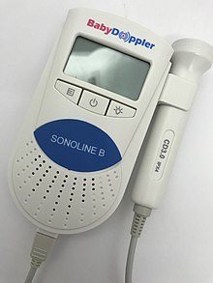

Slide 27
Umbilical Artery
Doppler is very important in the management of IUGR
Power Spectral Density (PSD) as a routine use of detecting IUGR is not proven to be better than fetal biometric parameters.
It has, however, been proven to be a good indicator of fetal outcome
Umbilical artery (UA) Doppler in suspected IUGR is performed.
If UA is normal, then no other Doppler investigations need to be performed.
If UA is abnormal, then other vessels should be evaluated.

Slide 28
With placental insufficiency, placental impedance is higher than normal and results in diastolic abnormalities such as decreased, absent, or reversed end-diastolic flow in fetal vessels.
These diastolic abnormalities in flow are best characterized by the standard Doppler indices (S/D ratio, RI, and PI).

Slide 29
The diastolic flow reversal in umbilical arteries signifies severe placental insufficiency and increased placental vascular resistance, which is bad news for the fetus.

Slide 30
Normally progressive decrease in resistance during the course of pregnancy.
RI <0.8
Systolic/diastolic ratio >3.0 is abnormal after 3o weeks
Ratios are higher if measured closer to fetal cord insertion, so measurements should be taken in UA close to placental cord insertion site
Absent or reversed diastolic flow in umbilical artery is ALWAYS an ominous sign

Slide 31
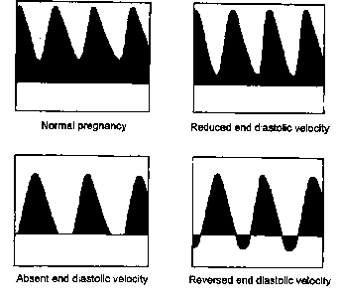
Abnormal UA Doppler waveform depends on the severity of disease.

Slide 32
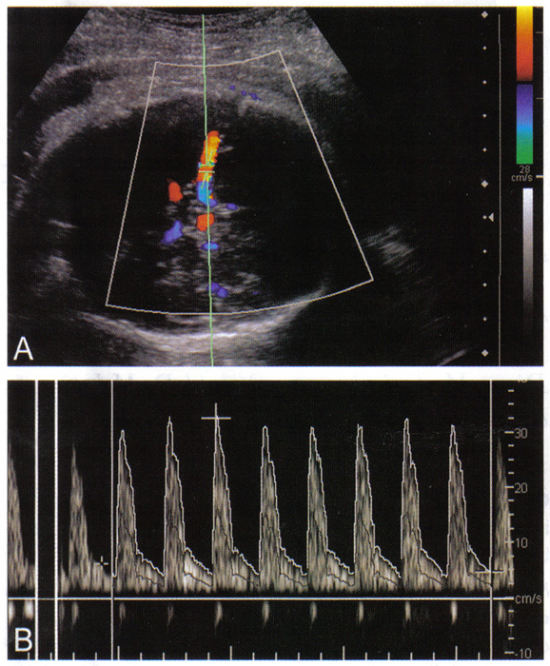
Normal MCA in the fetus

Slide 33
IUGR fetuses may be experiencing chronic hypoxemia (decreased blood oxygen concentration) .
With fetal hypoxemia, there is increased blood flow to vital organs (brain and myocardium) and reduced flow to the gastrointestinal tract and kidneys.
Thus, the PSV of a hypoxic fetus will show an increase in the MCA velocity.

Slide 34
MCA and ANEMIA
Middle Cerebral artery (MCA) Doppler can help determine likelihood of fetal anemia.
MCA is examined close to its origin from the internal carotid artery.

Slide 35
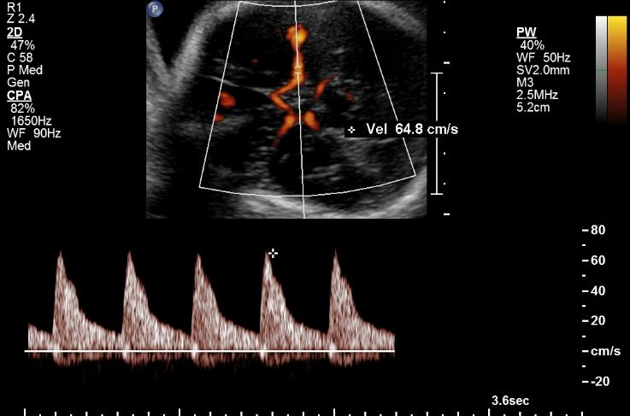
An abnormal MCA.

Slide 36
Uterine Artery
Low resistance in second and third trimesters is normal
Appearance of a ‘notch’ in Doppler waveform is abnormal and thought to predict insufficiency & IUGR

Slide 37
IVC Doppler waveforms can be obtained from a coronal plane of the chest and abdomen. In this view, the IVC can be imaged as it enters into the right atrium, joined by the ductus venosus and the left hepatic vein. The IVC waveforms are triphasic in shape, with the first phase corresponding to ventricular systole, the second phase to early diastole, and the third phase to late diastole or the atrial kick.

Slide 38
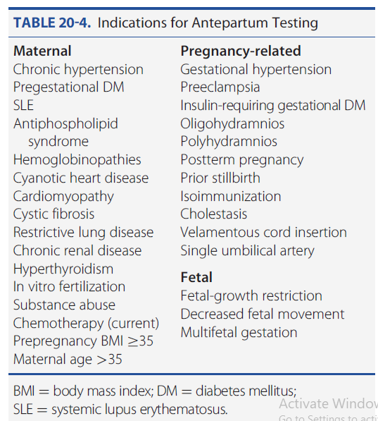
Indications for Antepartum Testing

Slide 39


